Slide 1
Dijkstra’s Algorithm
CSE 2202: Algorithm Analysis and Design Laboratory
Md. Mubtashim Abrar Nihal
Ms. Subah Nawar

Slide 2
Recap
We learnt the basic of graph theory in previous semester.
Nodes, Edges, Paths, etc.
We also learnt about graph traversal methods.
BFS and DFS.
We saw how we can find the shortest path between two nodes in an unweighted graph.
Using BFS.
But what if the graph is weighted?

Slide 3
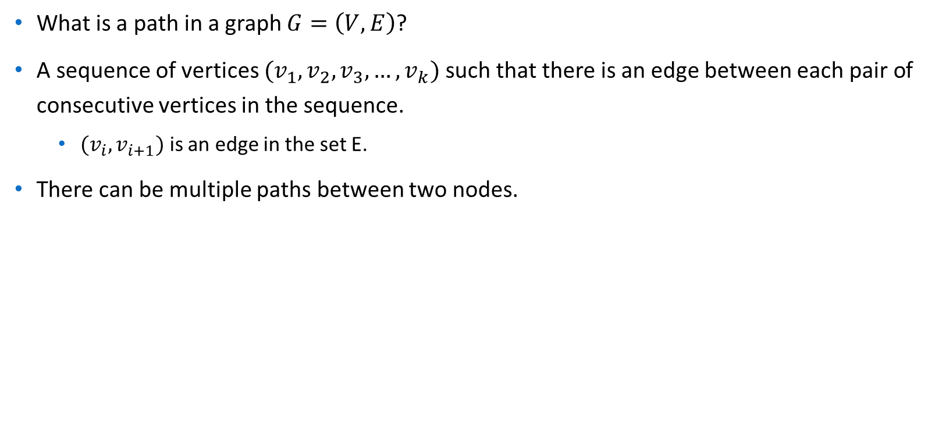
Shortest Path Problem
1
0
3
2

Slide 4
Shortest Path Problem
How do we find the shortest path now?
How can you say a path is longer/shorter than another one?
We need to assign a value to each path to compare them.
Let’s call this value the cost of a path.
We want to find the path with minimum cost.

Slide 5
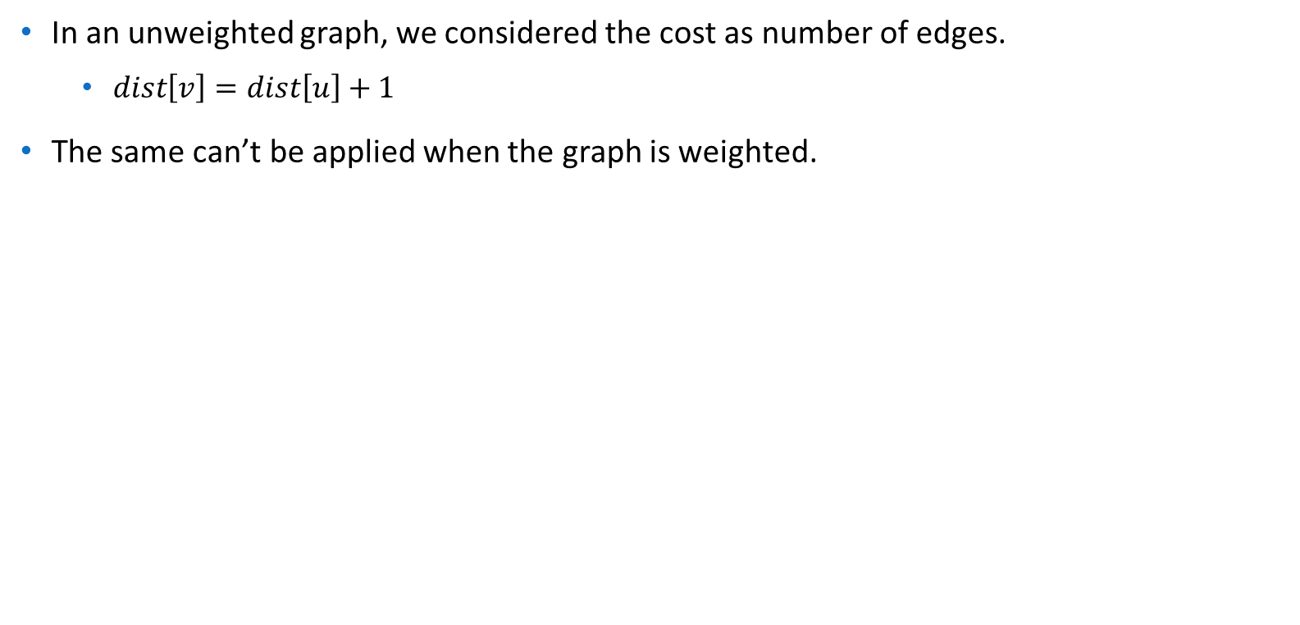
Cost of a Path
1
10
1
0
3
1
1
10
2

Slide 6
Cost of a Path
In general, the cost of a path is calculated by summing up the weights of the edges along the path.
But you can change the cost function.
Multiply the weights for example.

Slide 7
Finding the Shortest Path
Our target is to understand some well-known algorithms that will find the shortest path.
There are some variations in shortest path.
Single-pair shortest path.
Single-Source Shortest Path.
Single-Destination Shortest Path.
All-Pairs Shortest Path.
Let’s focus on Single Source Shortest Path (SSSP) Algorithms today.
Single Destination shortest path can be reduced to SSSP.

Slide 8
Single Source Shortest Path Algorithms
From a source vertex s, find the shortest path to all other vertices in the graph.
Some Common Algorithms
Dijkstra’s Algorithm
Bellman-Ford Algorithm
SPFA (Shortest Path Faster Algorithm)
Dial’s Algorithm
Thorup’s Algorithm
And So on.
We will talk about Dijkstra’s Algorithm today.

Slide 9
Dijkstra’s Algorithm
Choose a starting node.
Let dist[N] be the distance of node N from the source node.
Initially, set the distance of all the nodes to infinity.
We will try to improve the distances step by step.

Slide 10
Dijkstra’s Algorithm
Mark all nodes an unvisited. Create a set of all the unvisited nodes – unvisited set.
Assign to every node a distance from start value.
For starting node it is zero, For other nodes it is infinity.
From the unvisited set, select the node with smallest finite distance as current node.
For the current node, consider all of its unvisited neighbors and update their distance through the current node.
Mark the current node as visited and remove it from the unvisited.
Once the loop exits every visited node will contain its shortest distance from the starting node.

Slide 11
Algorithm Simulation
Let’s consider the following graph.
We will select node 0 as starting node.
1
4
2
6
10
2
0
3
6
6
1
15
6
2
5

Slide 12
Algorithm Simulation
We will need a distance array.
Initially all will have infinity except 0(source node)
distance
0 | 1 | 2 | 3 | 4 | 5 | 6
0
4
1
2
6
10
2
0
3
6
6
1
15
6
2
5

Slide 13
Algorithm Simulation
We also need an unvisited set.
We will maintain a visited array for this purpose.
visited
0 | 1 | 2 | 3 | 4 | 5 | 6
0 | 0 |  |  | 0 | 0
4
1
2
6
10
2
0
3
6
6
1
15
6
2
5

Slide 14
Algorithm Simulation
We need to find the node with minimum distance that is not marked visited.
It will be the source node initially.
1
4
2
6
10
2
0
3
6
6
1
15
6
2
5
Node | 0 | 1 | 2 | 3 | 4 | 5 | 6
visited | 0 | 0 |  |  | 0 | 0
distance | 0

Slide 15
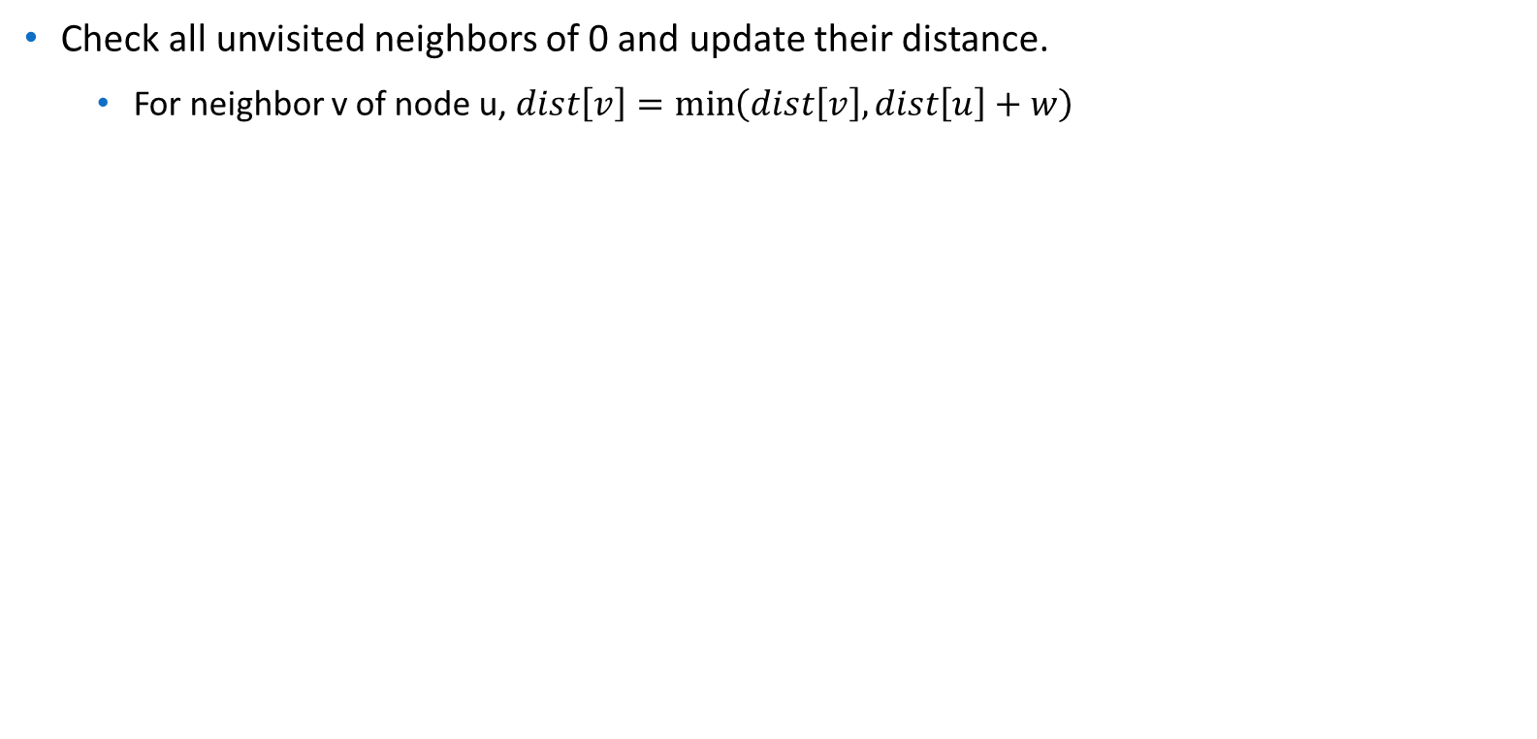
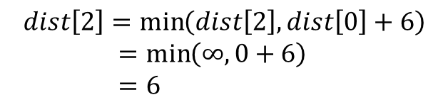
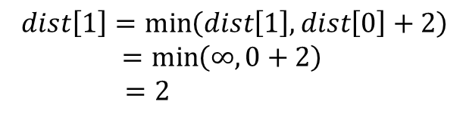
Algorithm Simulation
1
4
2
6
10
2
0
3
6
6
1
15
6
2
5
Node | 0 | 1 | 2 | 3 | 4 | 5 | 6
visited | 0 | 0 |  |  | 0 | 0
distance | 0
distance | 0
distance | 0

Slide 16
Algorithm Simulation
Finally, mark 0 as visited.
1
4
2
6
10
2
0
3
6
6
1
15
6
2
5
Node | 0 | 1 | 2 | 3 | 4 | 5 | 6
visited | 0 | 0 |  |  | 0 | 0
distance | 0
visited | 1 | 0 |  |  | 0 | 0

Slide 17
Algorithm Simulation
We repeat this loop (find unvisited node & update neighbors distance) until there’s no unvisited node.
1
4
2
6
10
2
0
3
6
6
1
15
6
2
5
Node | 0 | 1 | 2 | 3 | 4 | 5 | 6
visited | 1 | 0 |  |  | 0 | 0
distance | 0

Slide 18
Algorithm Simulation
Unvisited node with minimum distance.
1
1
4
2
6
10
2
0
3
6
6
1
15
6
2
5
Node | 0 | 1 | 2 | 3 | 4 | 5 | 6
visited | 1 | 0 |  |  | 0 | 0
distance | 0

Slide 19
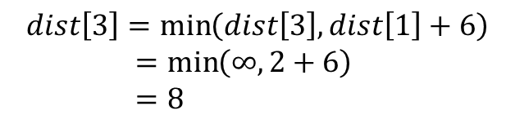
Algorithm Simulation
Update distance of neighbor (node 3).
1
4
2
6
10
2
0
3
6
6
1
15
6
2
5
Node | 0 | 1 | 2 | 3 | 4 | 5 | 6
visited | 1 | 0 |  |  | 0 | 0
distance | 0
distance | 0 |  |  | 8

Slide 20
Algorithm Simulation
Finally, mark 1 as visited.
1
4
2
6
10
2
0
3
6
6
1
15
6
2
5
Node | 0 | 1 | 2 | 3 | 4 | 5 | 6
visited | 0 | 0 |  |  | 0 | 0
distance | 0
visited | 1 | 1 |  |  | 0 | 0

Slide 21
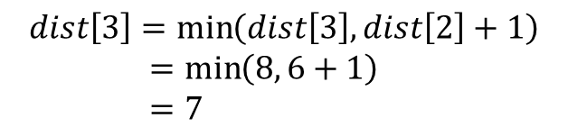
Algorithm Simulation
Current Node
2
Neighbor Node
3
1
4
2
6
10
2
0
3
6
6
1
15
6
2
5
No more neighbors. Mark 2 as visited.
Node | 0 | 1 | 2 | 3 | 4 | 5 | 6
visited | 0 | 0 |  |  | 0 | 0
distance | 0
visited | 1 | 1 |  |  | 0 | 0
visited | 1 | 1 |  |  | 0 | 0
distance | 0

Slide 22
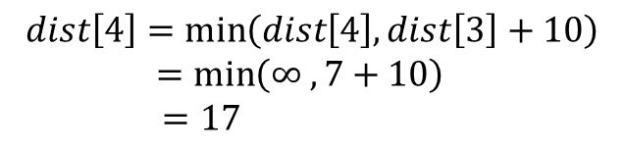
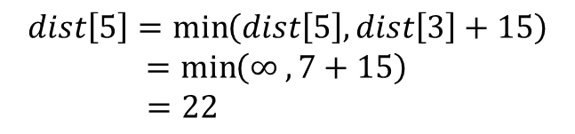
Algorithm Simulation
Current Node
3
Neighbor Node
5
4
4
1
2
6
10
2
0
3
6
6
1
15
6
2
5
Node | 0 | 1 | 2 | 3 | 4 | 5 | 6
visited | 1 | 1 | 1 |  | 0 | 0
distance | 0 |  |  | 7
visited | 1 | 1 | 1 |  | 0 | 0
distance | 0
distance | 0

Slide 23
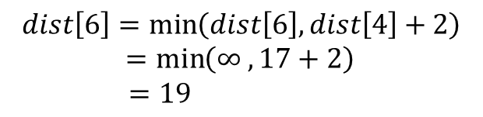
Algorithm Simulation
Current Node
4
Neighbor Node
6
1
4
2
6
10
2
0
3
6
6
1
15
6
2
5
Node | 0 | 1 | 2 | 3 | 4 | 5 | 6
visited | 1 | 1 | 1 |  | 0 | 0
distance | 0 |  |  | 7
visited | 1 | 1 | 1 |  | 1 | 0
distance | 0 |  |  | 7

Slide 24
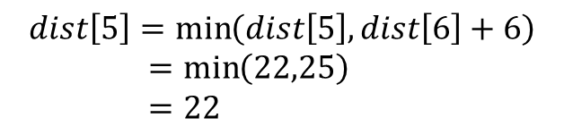
Algorithm Simulation
Current Node
6
Neighbor Node
5
1
4
2
6
10
2
0
3
6
6
1
15
6
2
5
Node | 0 | 1 | 2 | 3 | 4 | 5 | 6
visited | 1 | 1 | 1 |  | 1 | 0
distance | 0 |  |  | 7
visited | 1 | 1 | 1 |  | 1 | 0

Slide 25
Algorithm Simulation
Current Node
5
Neighbor Node
1
4
2
6
10
2
0
3
6
6
1
15
6
2
5
Node | 0 | 1 | 2 | 3 | 4 | 5 | 6
visited | 1 | 1 | 1 |  | 1 | 0 | 1
distance | 0 |  |  | 7
visited | 1 | 1 | 1 |  | 1 | 1 | 1

Slide 26
Implementation
Dijkstra (Graph, source)
Create vertex set Q
for each vertex v in Graph:
distance[v]:= infinity
add v to Q
distance[source] := 0
While Q is not empty:
u:= vertex in Q with smallest distance[] value
Remove u from Q
For each neighbor v of u where v is in Q:
Relax distance[v]
The process of relaxing an edge (u,v) consists of
testing whether going through vertex u
improves the shortest path to vertex v
found so far and, if so, updating distance[v]

Slide 27
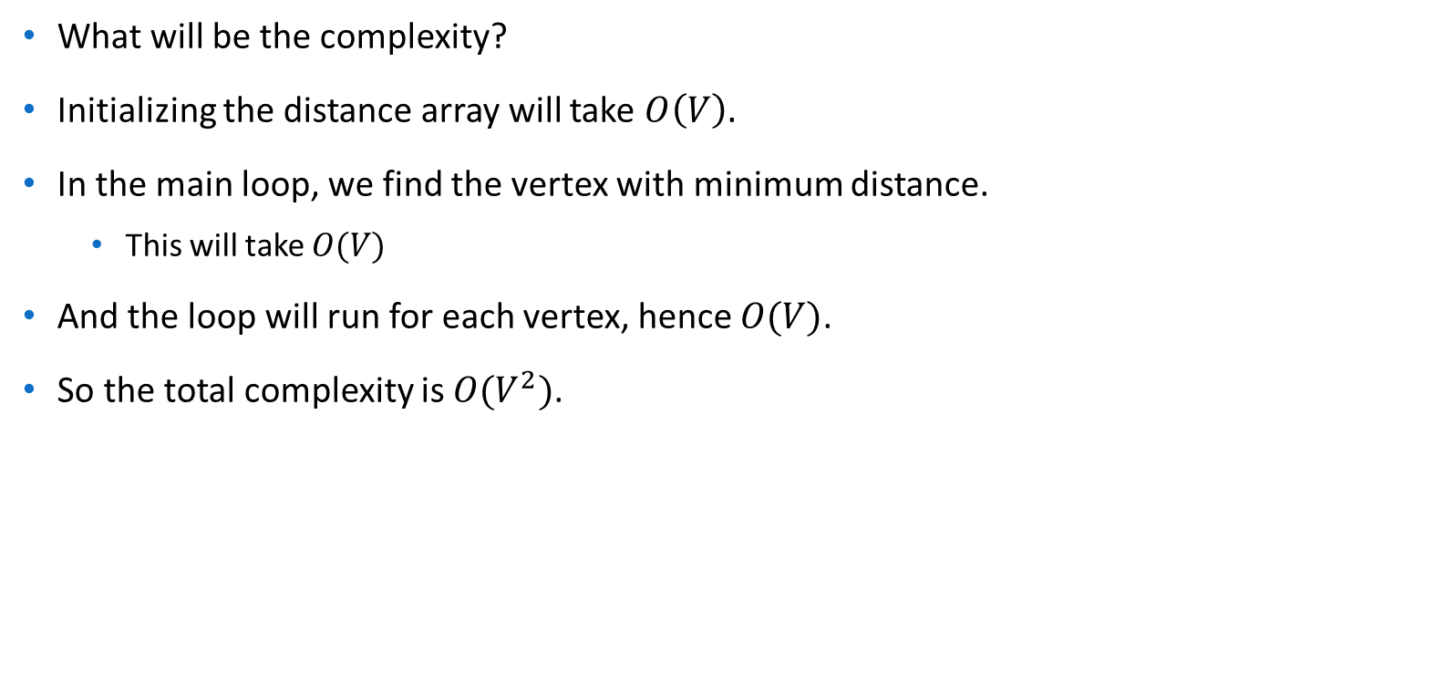
Complexity Analysis

Slide 28
Improving the Complexity
In Dijkstra’s Algorithm, we repeatedly tried to find the minimum value in an array.
Can you remember any data structure that can find the minimum of an array in constant time?
We can use a min-heap in this case.
The min-heap will support two operations:
Extract-Min
Find the node with minimum distance
Decrease-Key
Reduce the distance of a given node.

Slide 29
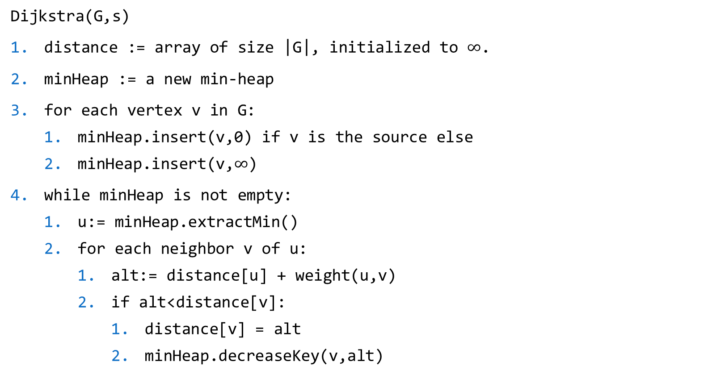
Pseudocode with Min-Heap

Slide 30
Using STL
We can either use set or priority_queue that supports the operation of heap.
In both data structure we will store data as pairs – the distance and the index of the vertex.
You need to use some workaround while using priority_queue.
It is a max-heap.
It does not support removing of a random element.
Can’t use decreaseKey operation.

Slide 31
References
Introduction to Algorithm, 4th ed, Leiserson, Charles Eric, Ronald L. Rivest, Thomas H. Cormen, and Clifford Stein.
Dijkstra’s Algorithm for Adjacency List Representation | Greedy Algo-8 – GeeksforGeeks
Dijkstra's Shortest Path Algorithm using priority_queue of STL - GeeksforGeeks
Dijkstra on sparse graphs - Algorithms for Competitive Programming (cp-algorithms.com)

